Slide 1


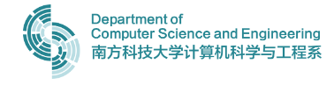

CrashSimGen: Generating Critical Scenarios with Diffusion Models for self-Driving
赖海斌 申文琨
CS329 Machine Learning (H) Project of Scenario Generation via Diffusion Model

Slide 2
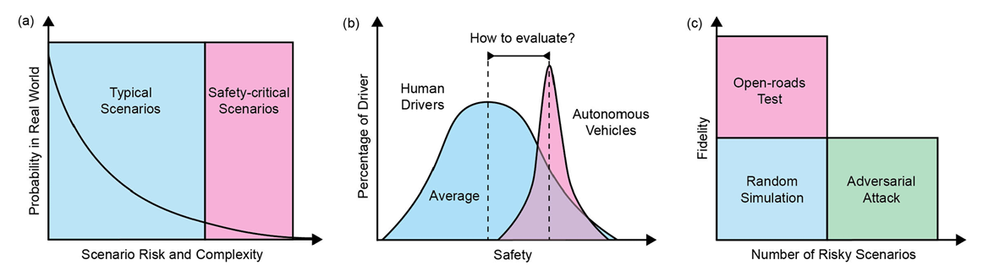
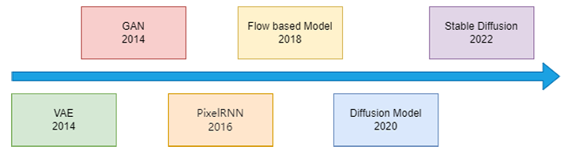
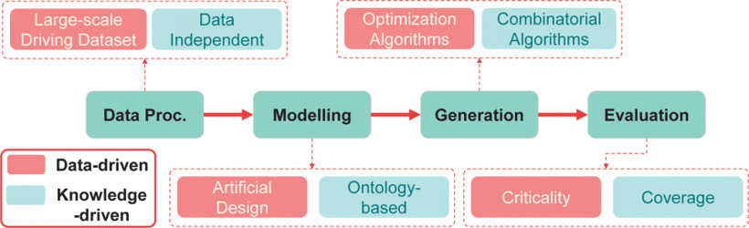
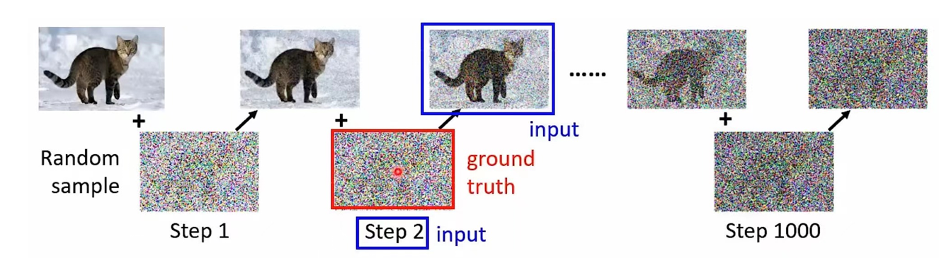
Introduction of Critical Scenario and Diffusion Model
Critical Scenario:
The Heart of Autonomous Driving
Diffusion Model:
the most advanced Data-Driven Model
The Data amount of Critical Scenario is small [5]
Critical Scenario Data is essential for AV [6,8]
In recent years, Data-driven Model can generate more critical scenario then other model [3,5,6,7]
With the rapid advancement of Generative Models, various methodologies for data-driven critical scenario generation have emerged.
Among these, the Diffusion Model stands as the most sophisticated and cutting-edge approach. [24]
Notes:
危险驾驶数据集的重要性；生成式模型在生成的重要性；扩散模型的新兴；

Slide 3
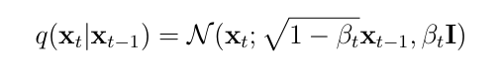
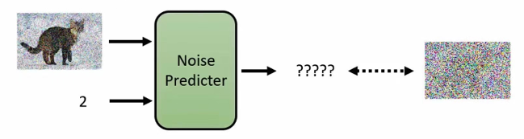
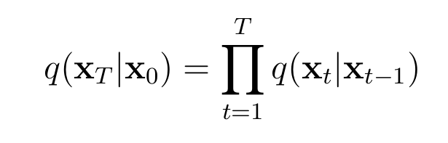
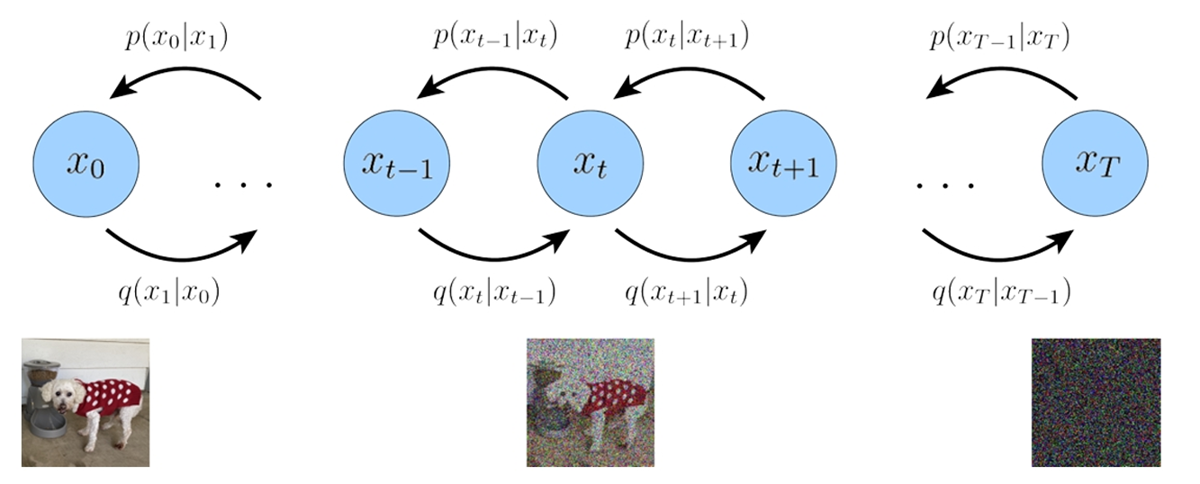
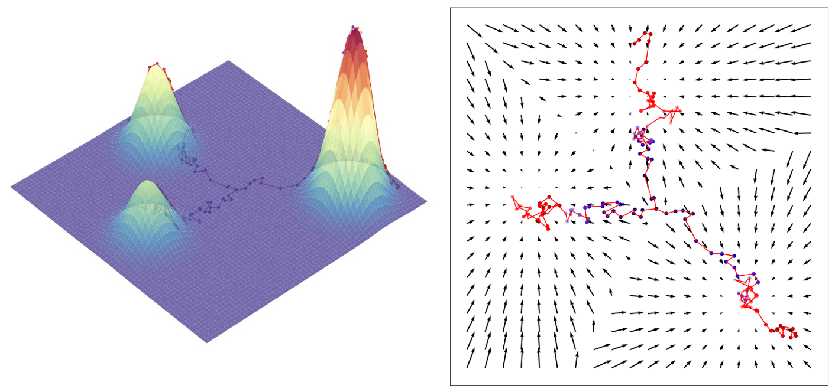
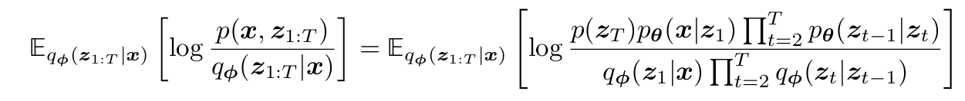
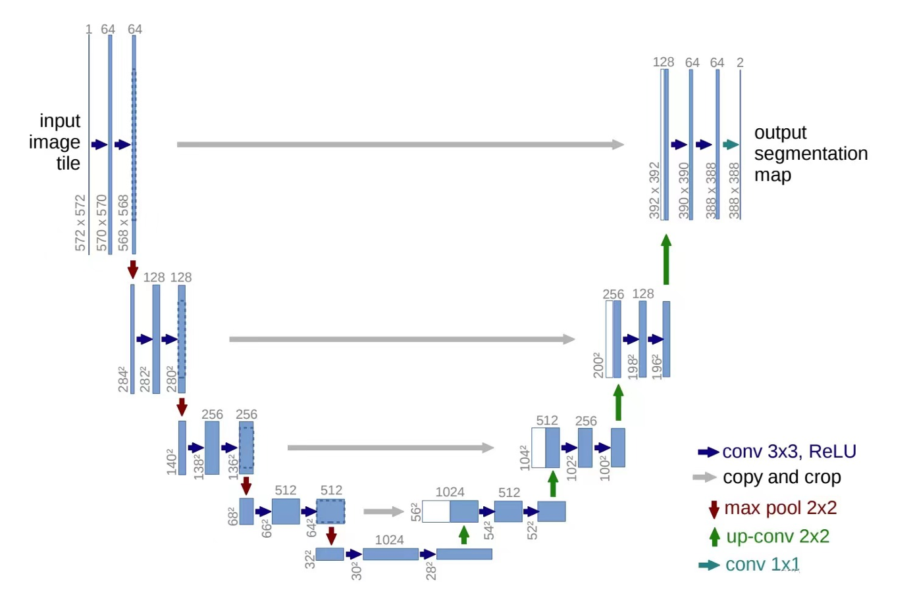
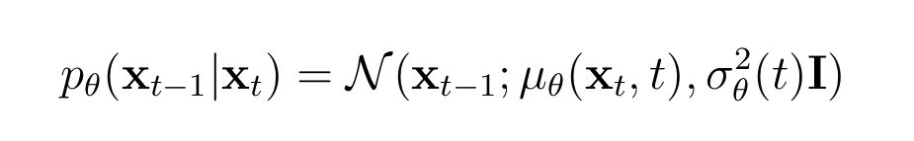
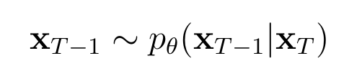
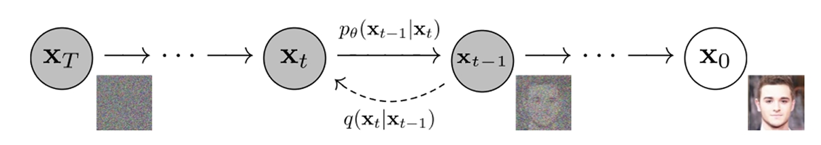
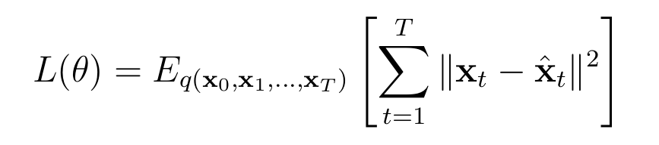
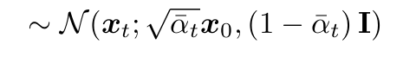
Forward Diffusion Process
Forward Process
Total Forward Process
Math Principle of Diffusion Model
Variational Diffusion Models
Reverse Process
Inference Process
Learning Process
Objective Function
Notes:
扩散模型的原理

Slide 4
Motivation & Related work
Can we utilize Diffusion Model to generate high quality Critical Scenario and run on Carla?
Current Related Works | Use Diffusion Model? | Sampling on Biggest Dataset? | Critical Scenario? | CARLA Simulation and Validation ?
WCDT (CVPR 2024) | ✅ | ✅ | ❌ | ❌
DriveSceneGen (RA-L 2024) | ✅ | ✅ | ❌ | ❌
ChatScene (CVPR 2024) | ❌ | ❌ | ✅ | ✅
Scenario Diffusion (NeurIPS 2023) | ✅ | ❌ | ❌ | ❌
DiffScene | ✅ | ❌ | ✅ | ❌
CTG (ICRA 2023) | ✅ | ❌ | ❌ | ❌
CrashSceneGen (Our Work) | ✅ | ✅ | ✅ | ✅
Notes:
诞生了我们的想法：我们想做一个End to End 的基于扩散模型的危险场景生成器

Slide 5
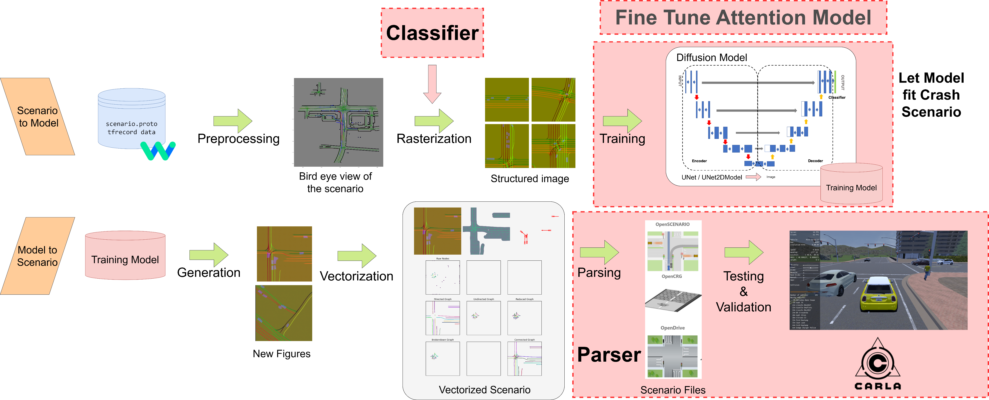
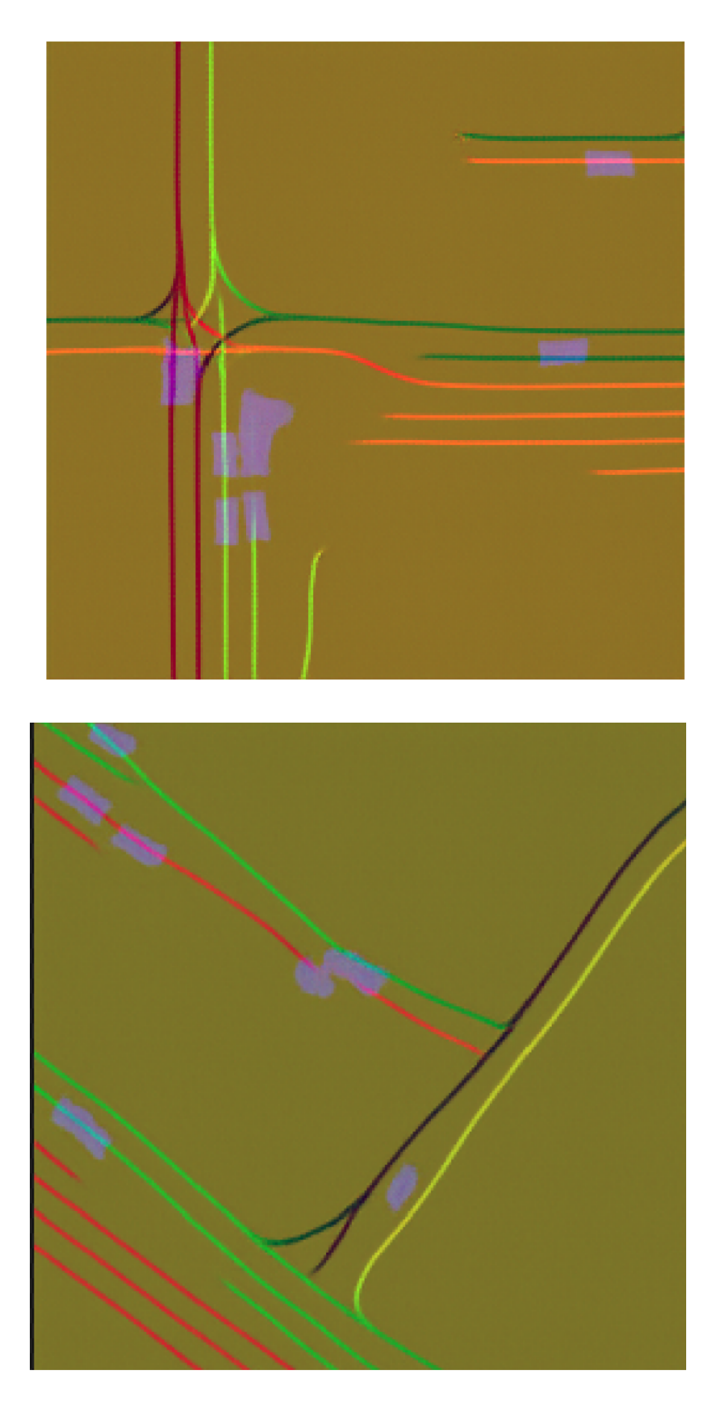
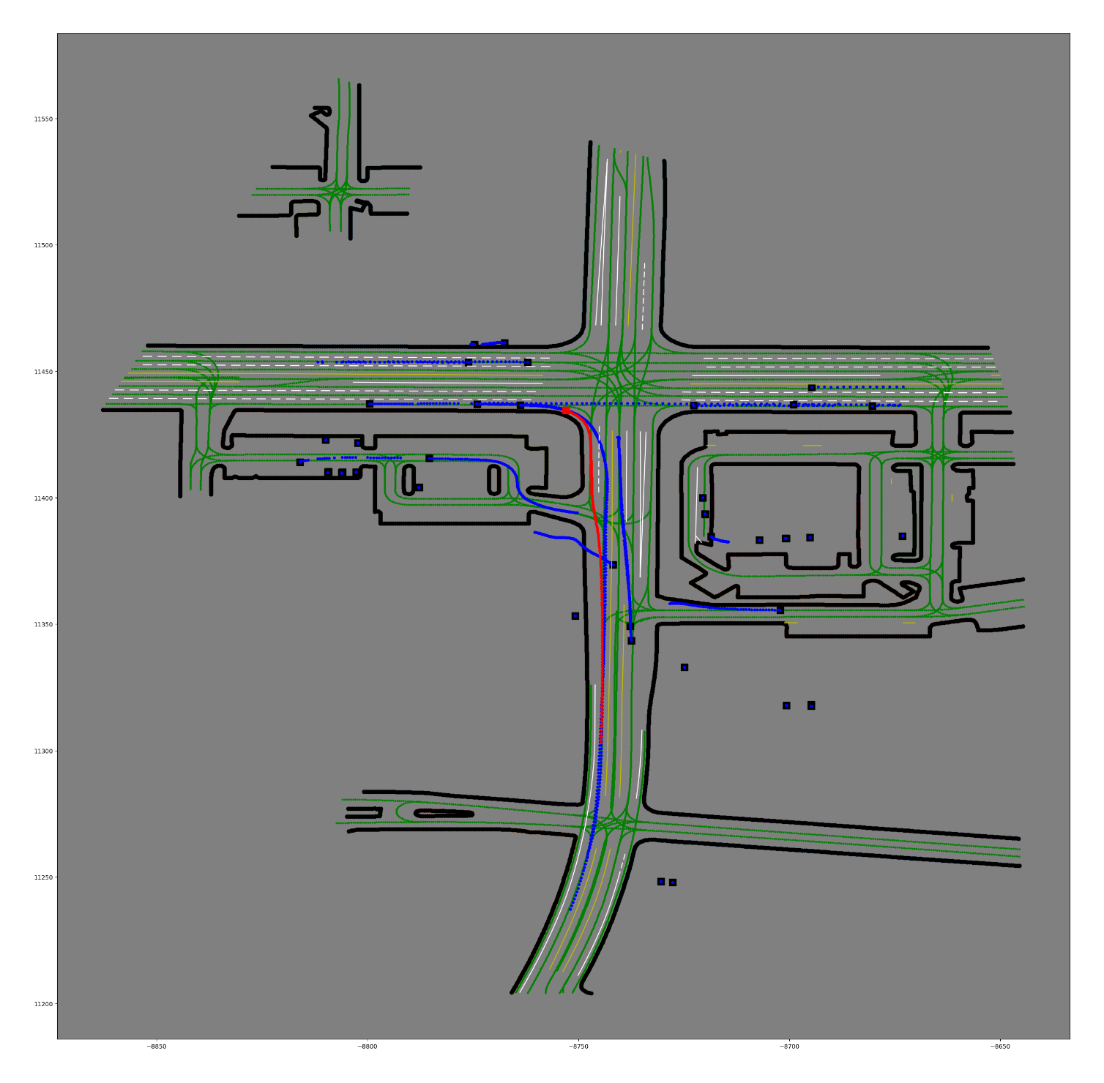
Project Contribution & Workflow
1. A Critical Scenario Classifier
2. A fine-tuned Attention-based UNet2D Diffusion Model
3. A parser for Carla

Slide 6
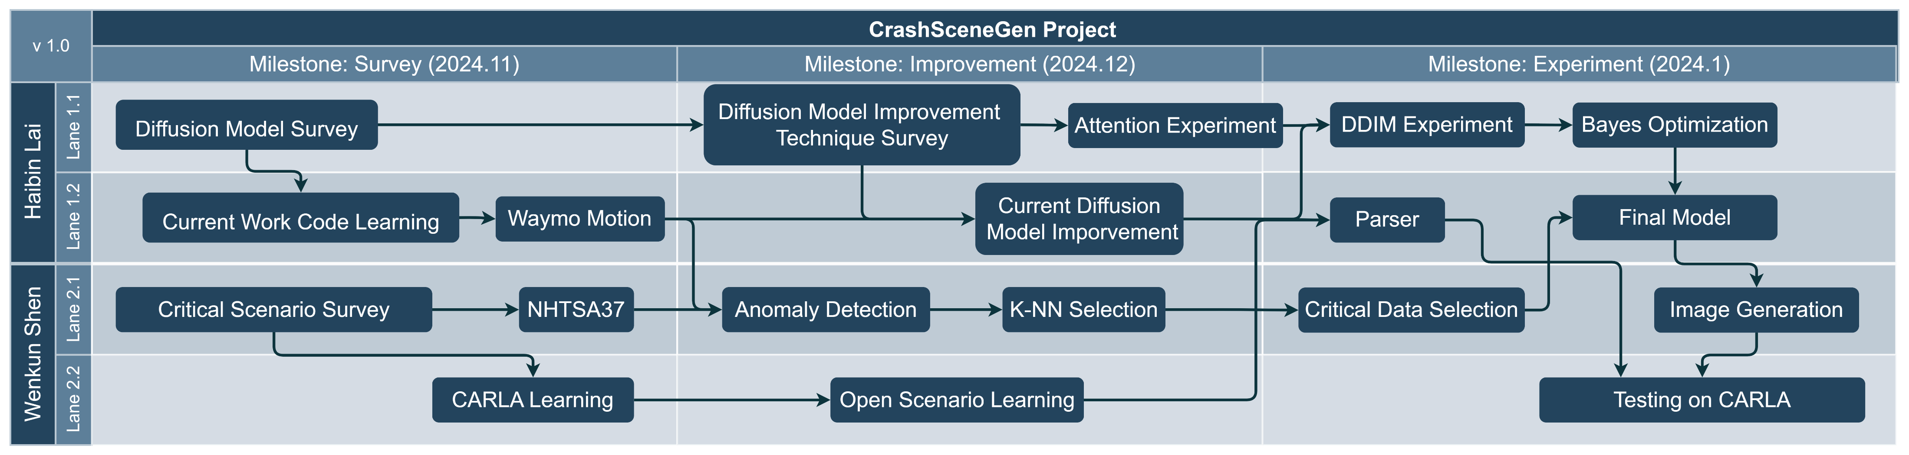
Timeline & Collaboration
Haibin Lai: Diffusion Model
Wenkun Shen: Autonomous Driving
Diffusion Model Survey
Model Training & Fine tuning
OpenScenario Parser
Critical Scenario Survey
Anomaly Selection on Waymo Motion
CARLA Simulation

Slide 7

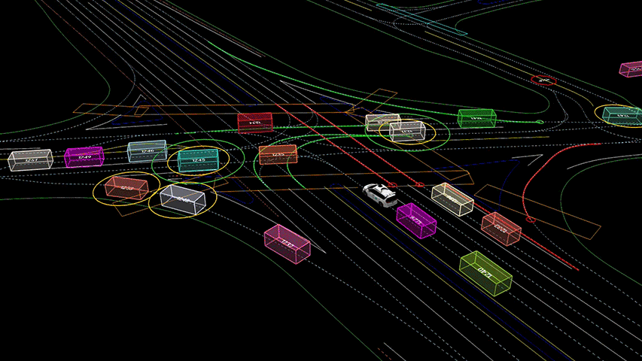
Problem Formulation
Dataset: Waymo Motion 1.1[1]
timestamps_seconds: 0.0
timestamps_seconds: 0.1007399559
...
timestamps_seconds: 19.819303989
tracks {
id: 256
object_type: TYPE_VEHICLE
states {
center_x: -8722.66015625
center_y: 11436.5078125
center_z: -81.47144317626953
length: 4.34753942489624
width: 1.9968481063842773
height: 1.7485830783843994
heading: 0.01599435135722
velocity_x: 9.62890625
velocity_y: 0.048828125
valid: true
}
...
dynamic_map_states {
Waymo Motion | Parameters
Recorded Data length | 574 hours
Data Size | About 860 GB
10Hz Segments | 103,354
Scenarios/Frames | Over 200,000 / Over 2000 millions

Slide 8
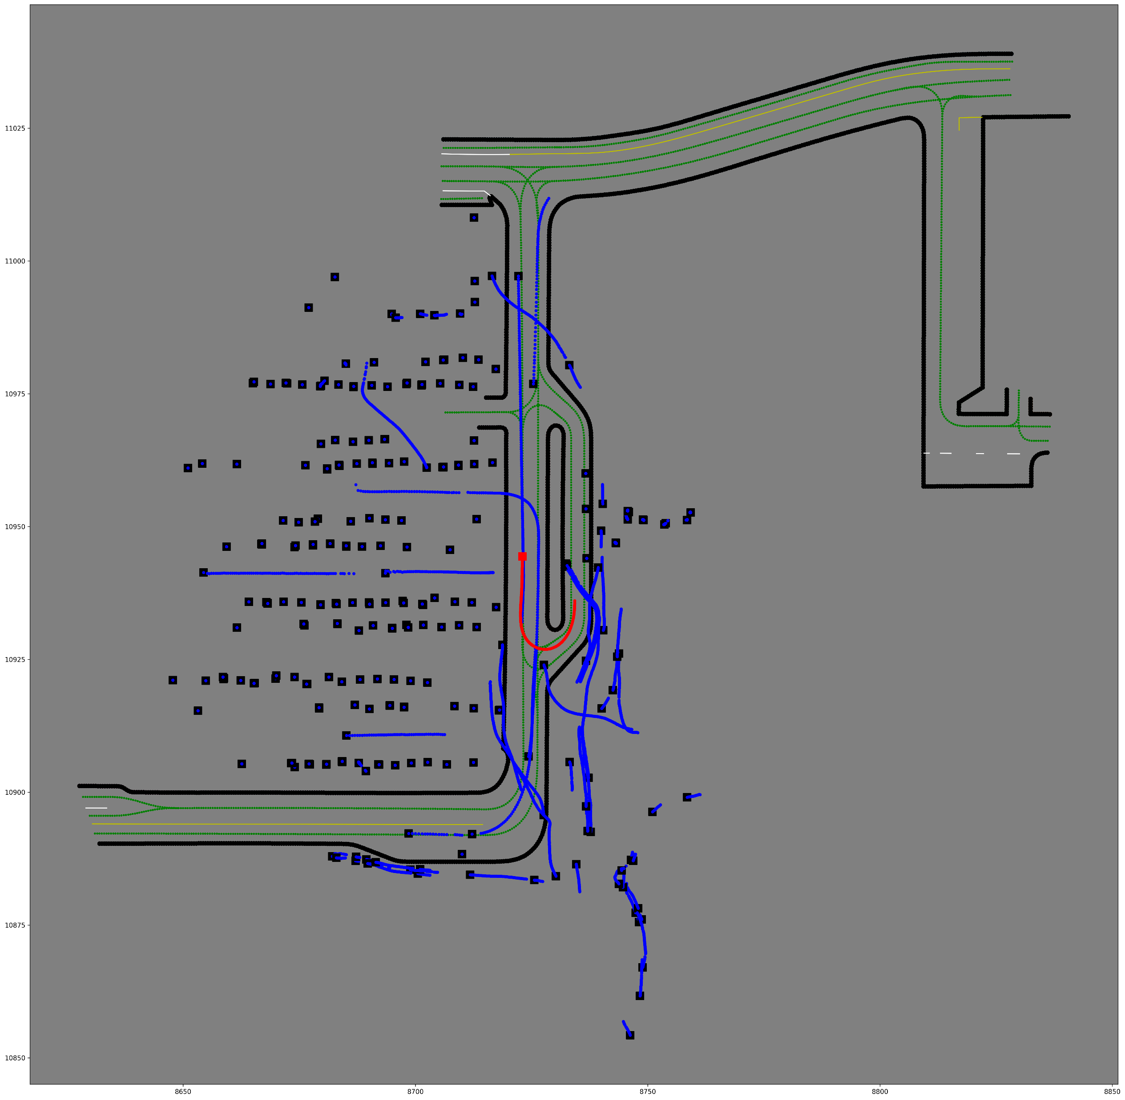
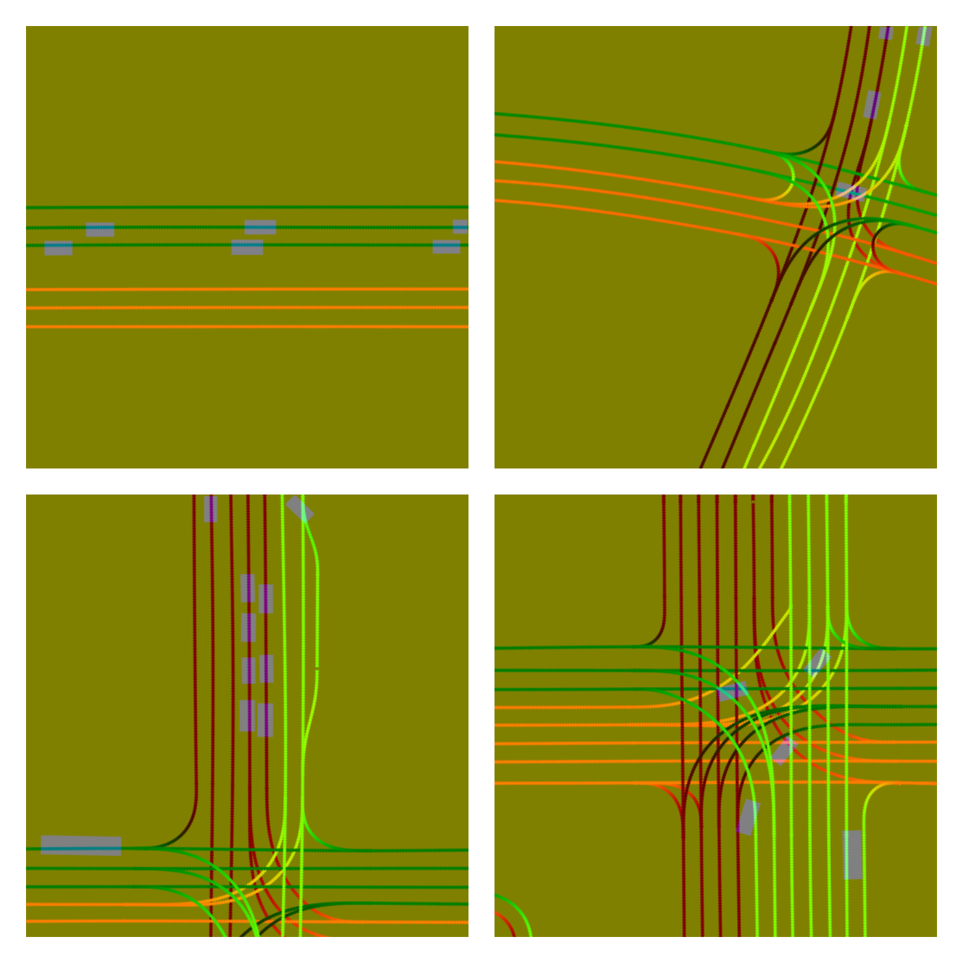

Problem Formulation
Dataset: Waymo Motion[1]

Slide 9
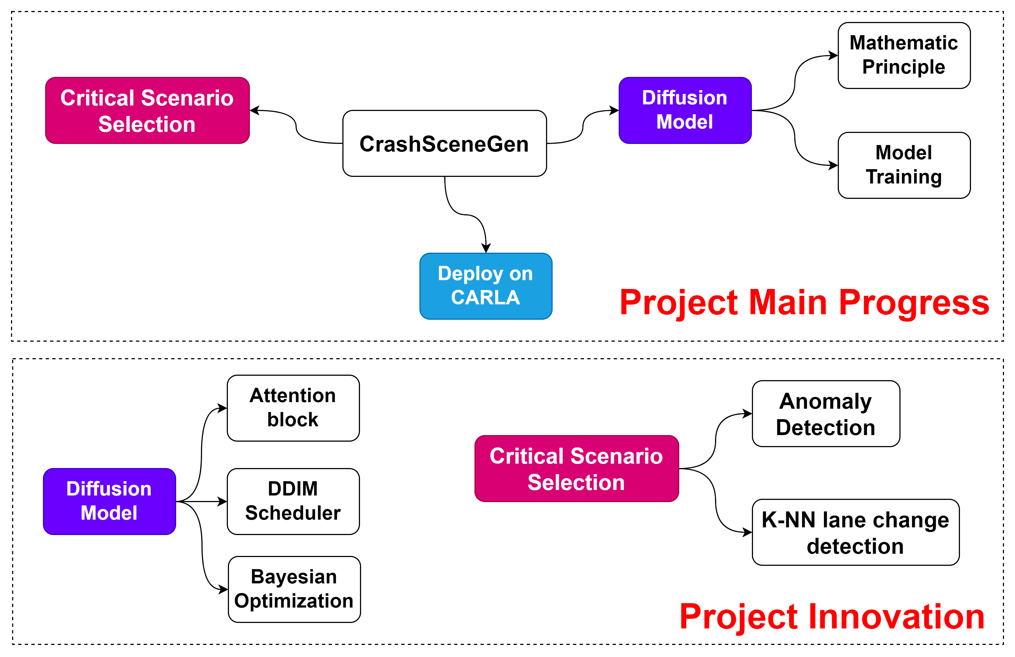
Project Goal
State-of-the-art work Evaluation✅
Literature review ✅
Model evaluation and selection✅
Critical data selection✅
Improve the model to fit critical scenario✅
Generate the result and run on Carla✅

Slide 10

Novelty of Our Project
Anomaly detection and critical scenario selection
A fine-tuned attention-based Diffusion Model with fast scheduler
Train faster and achieve lower loss then the SOTA model
A graph-based open-scenario generator for CARLA
CARLA 0.9.15

Slide 11
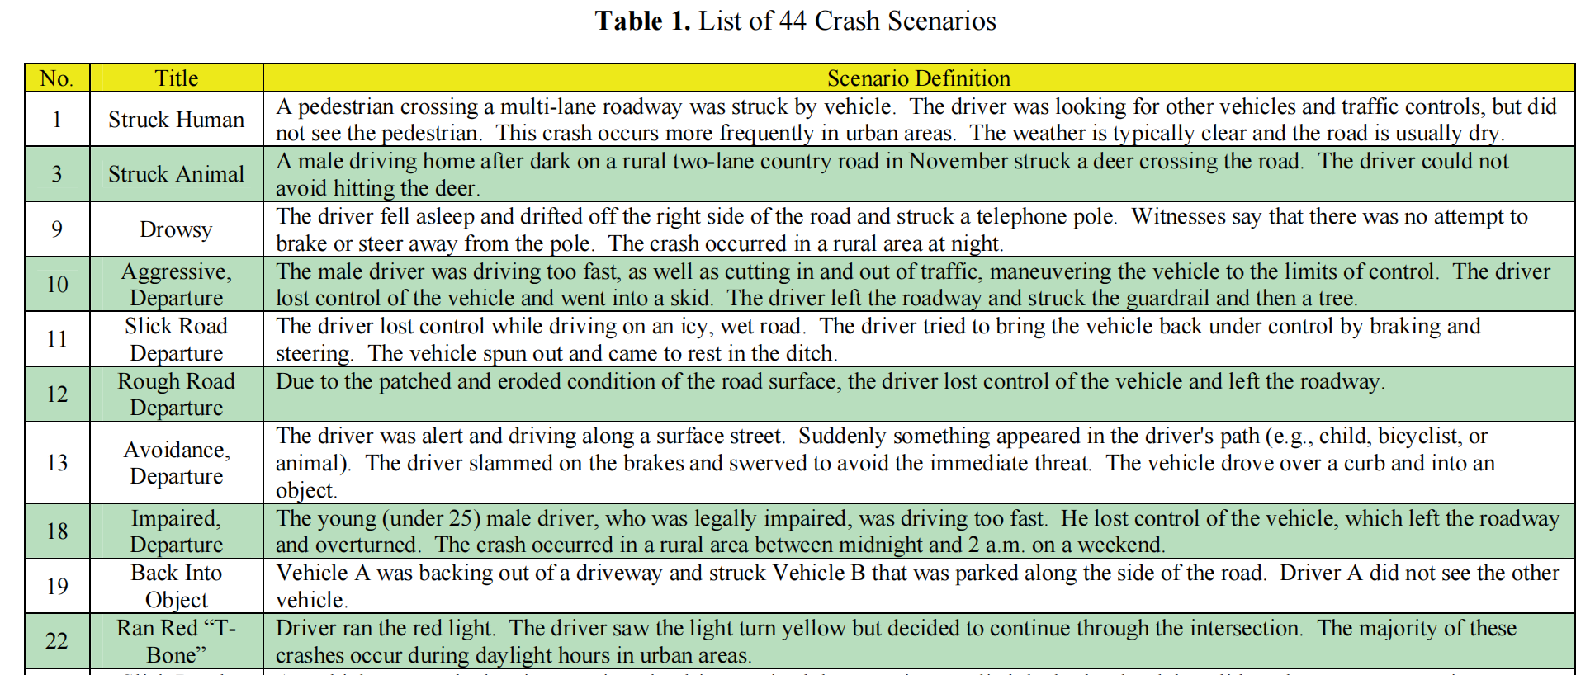
Motivation: select Critical Scene based on NHTSA37
Isolation Forest on Speed Detection
K-NN Based Lane Change Detection

Slide 12
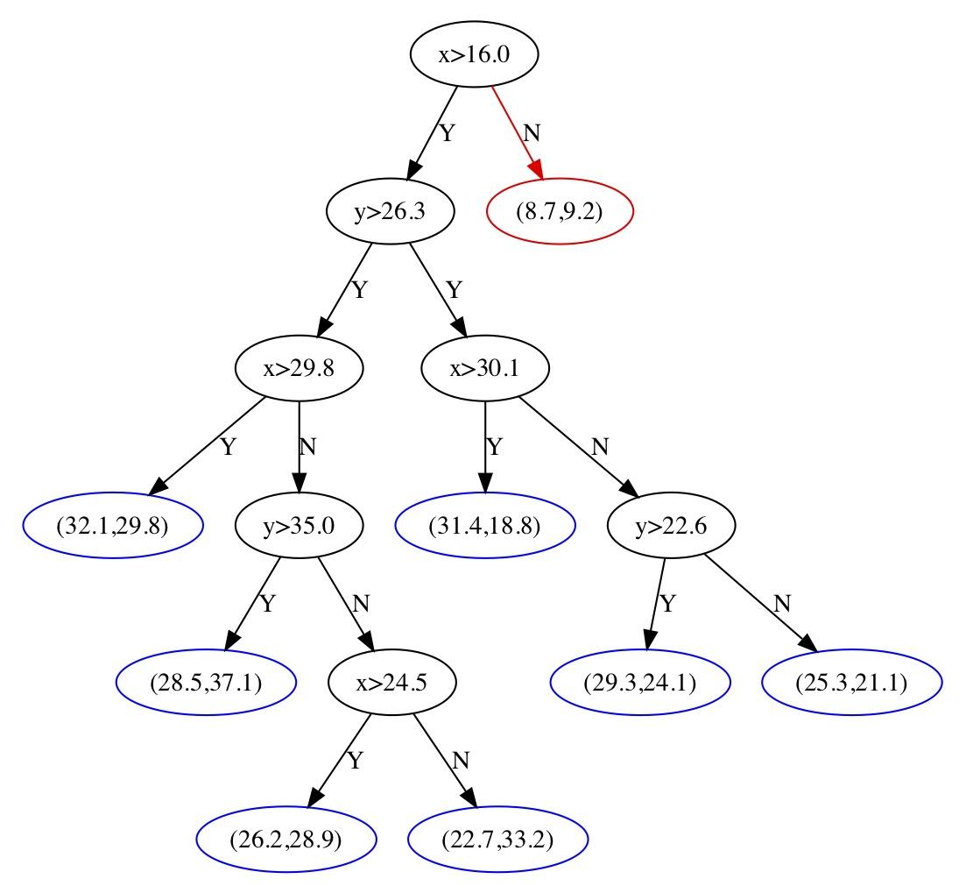
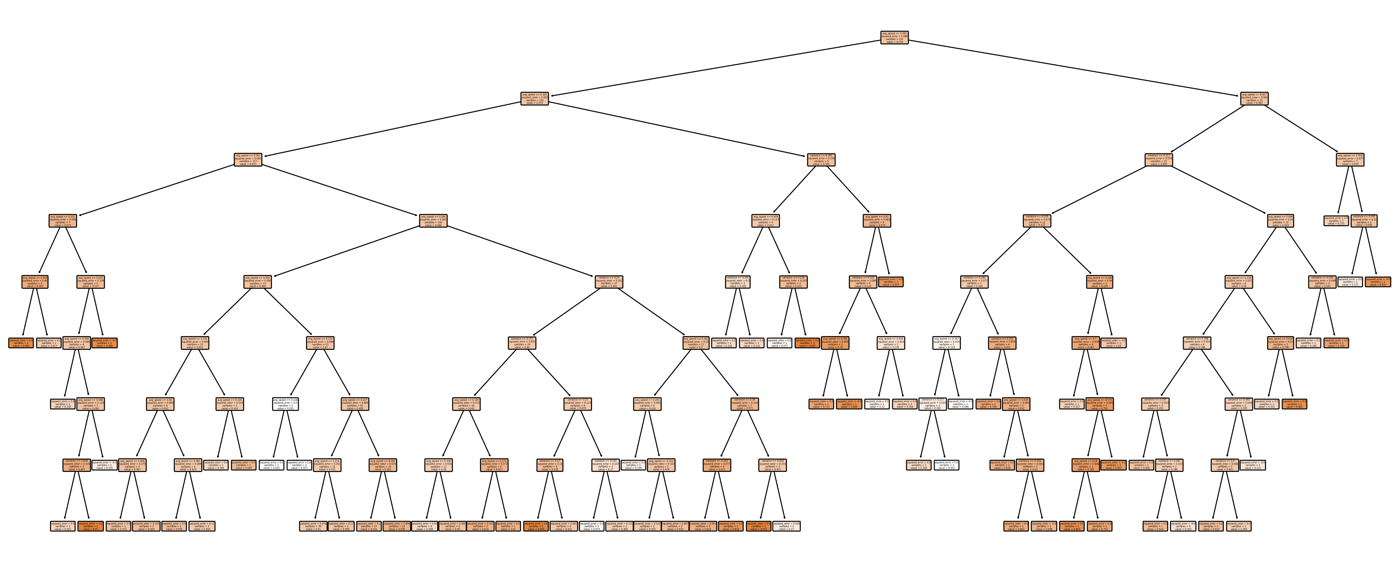
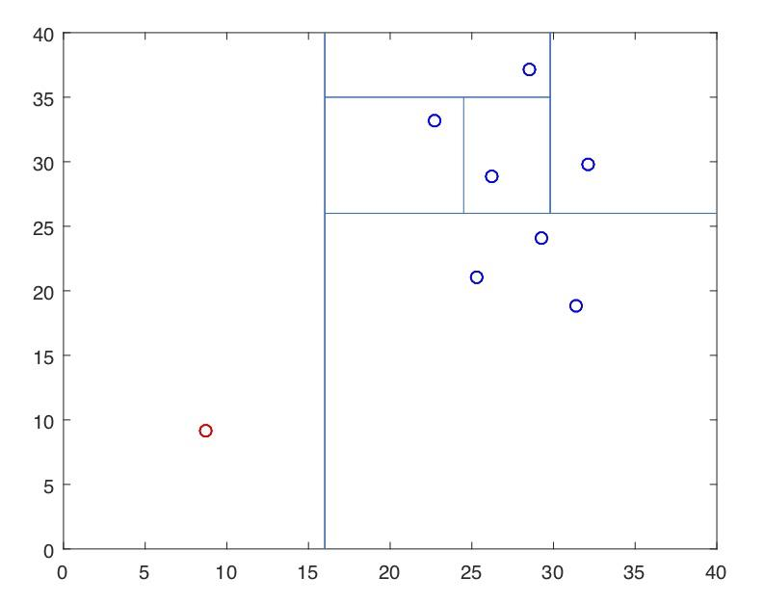
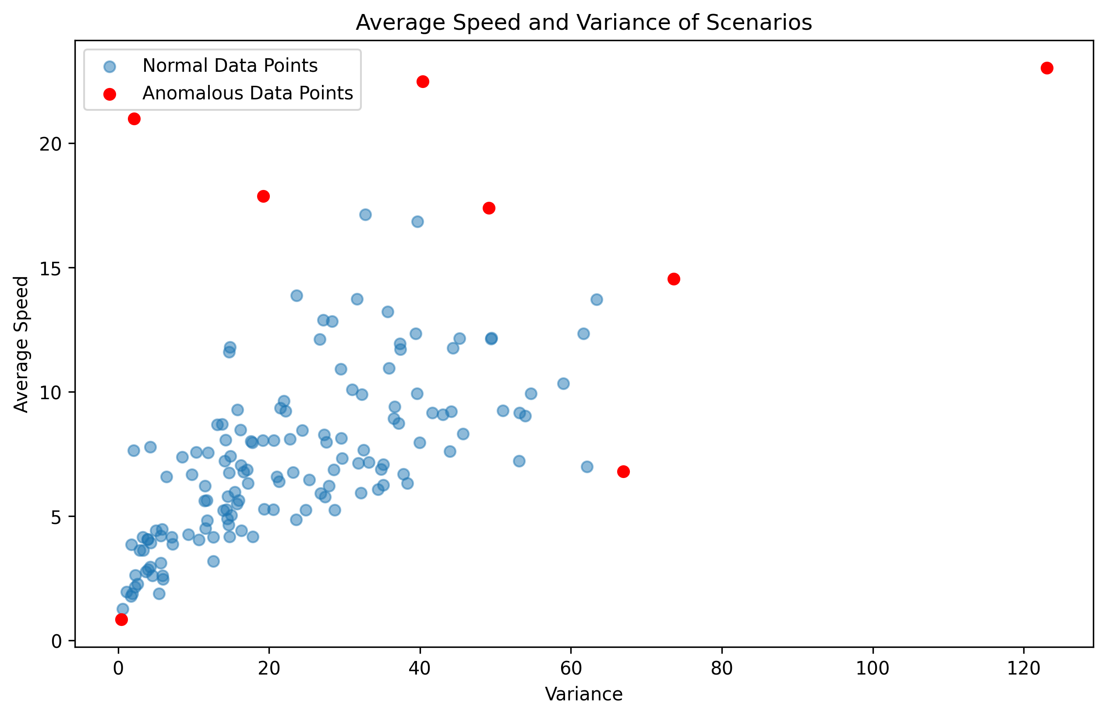
Anomaly Detection using Isolation Forest on Vehicle Speed
Average Speed and Variance of vehicle in tfrecord-001

Slide 13
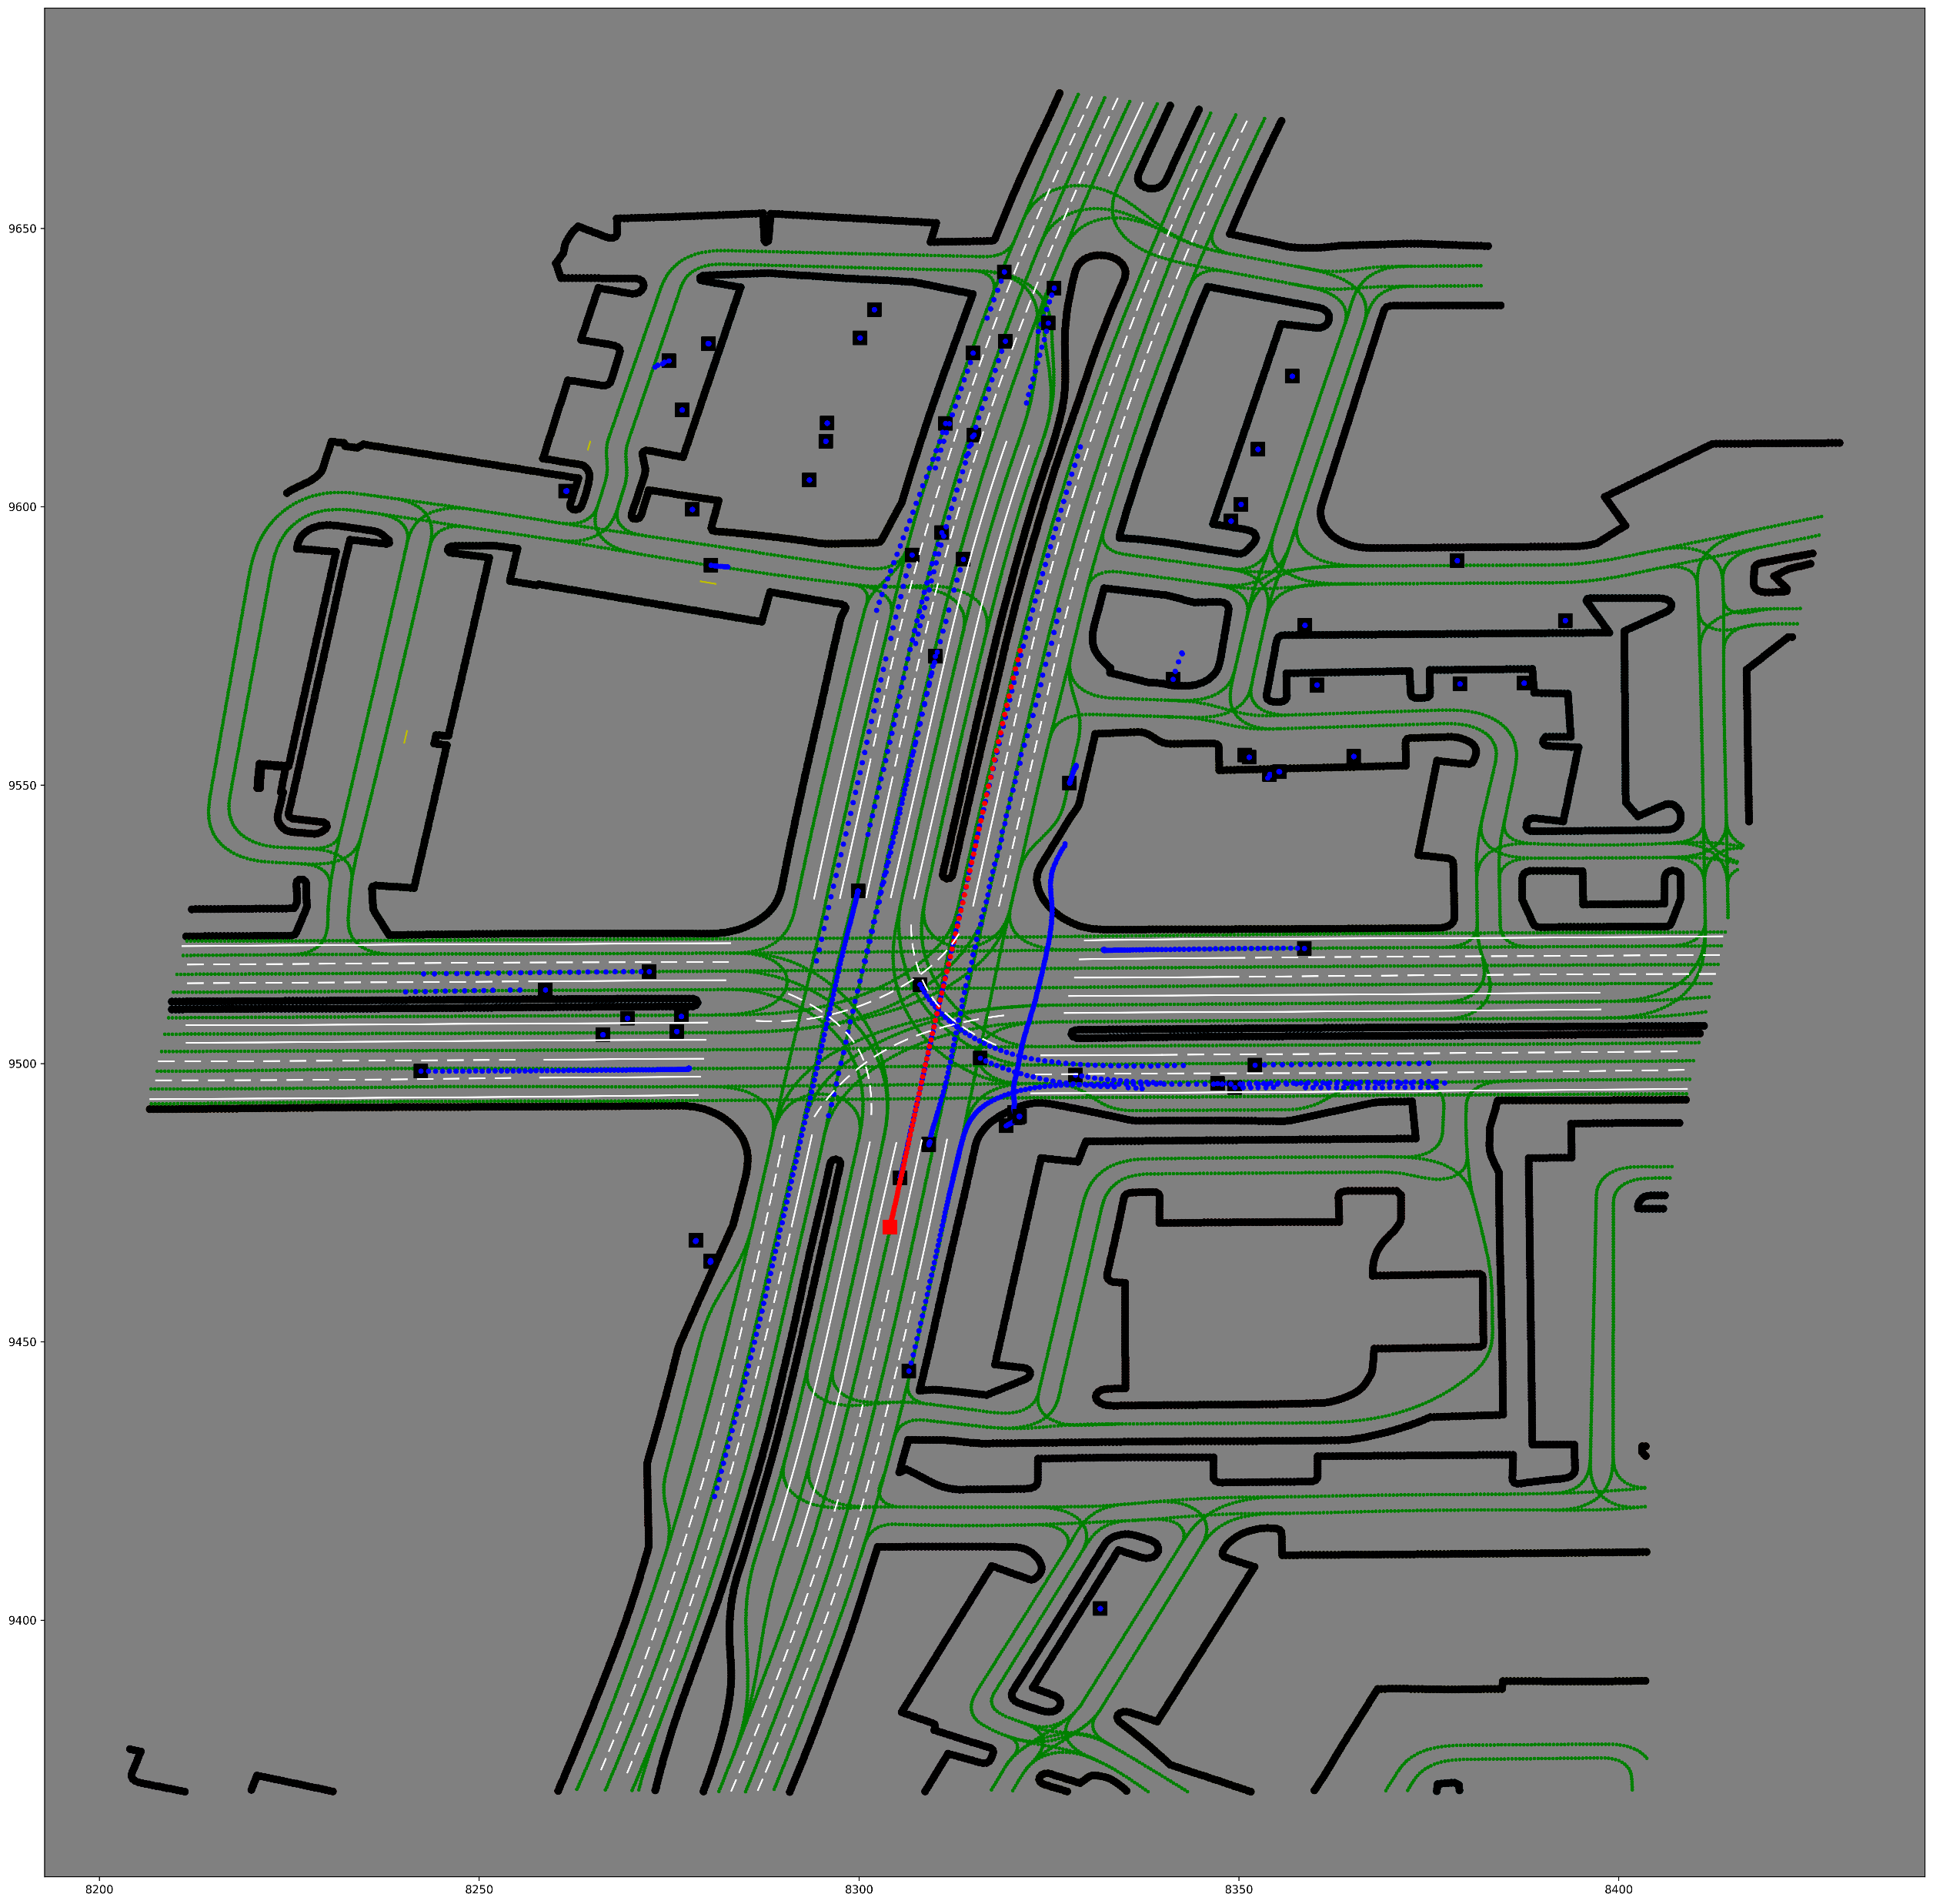
Solution: Anomaly Detection on Speed
Average Speed and Variance of vehicle in tfrecord-001
Notes:
这里是介绍

Slide 14
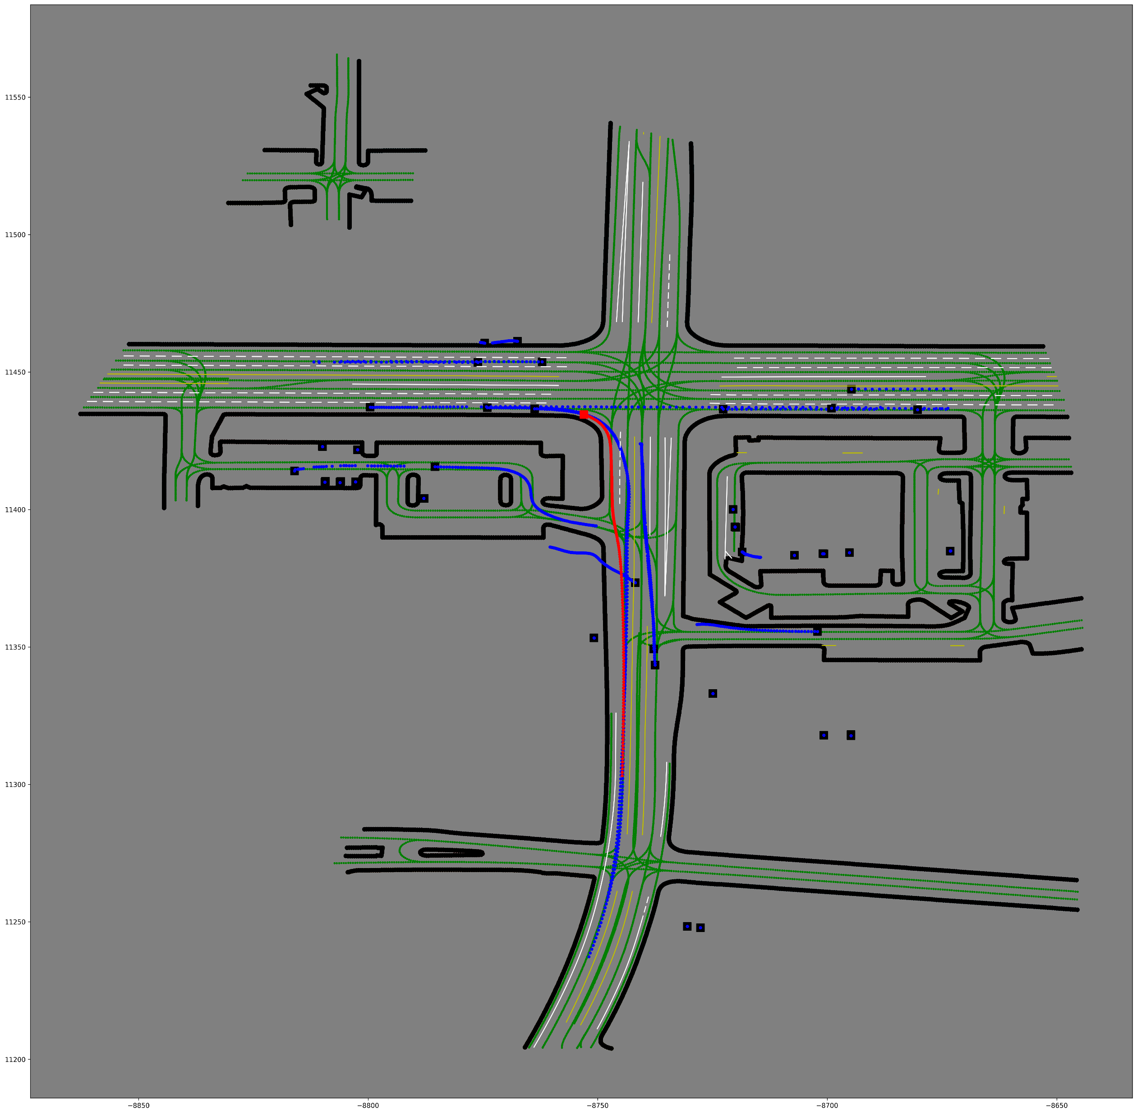
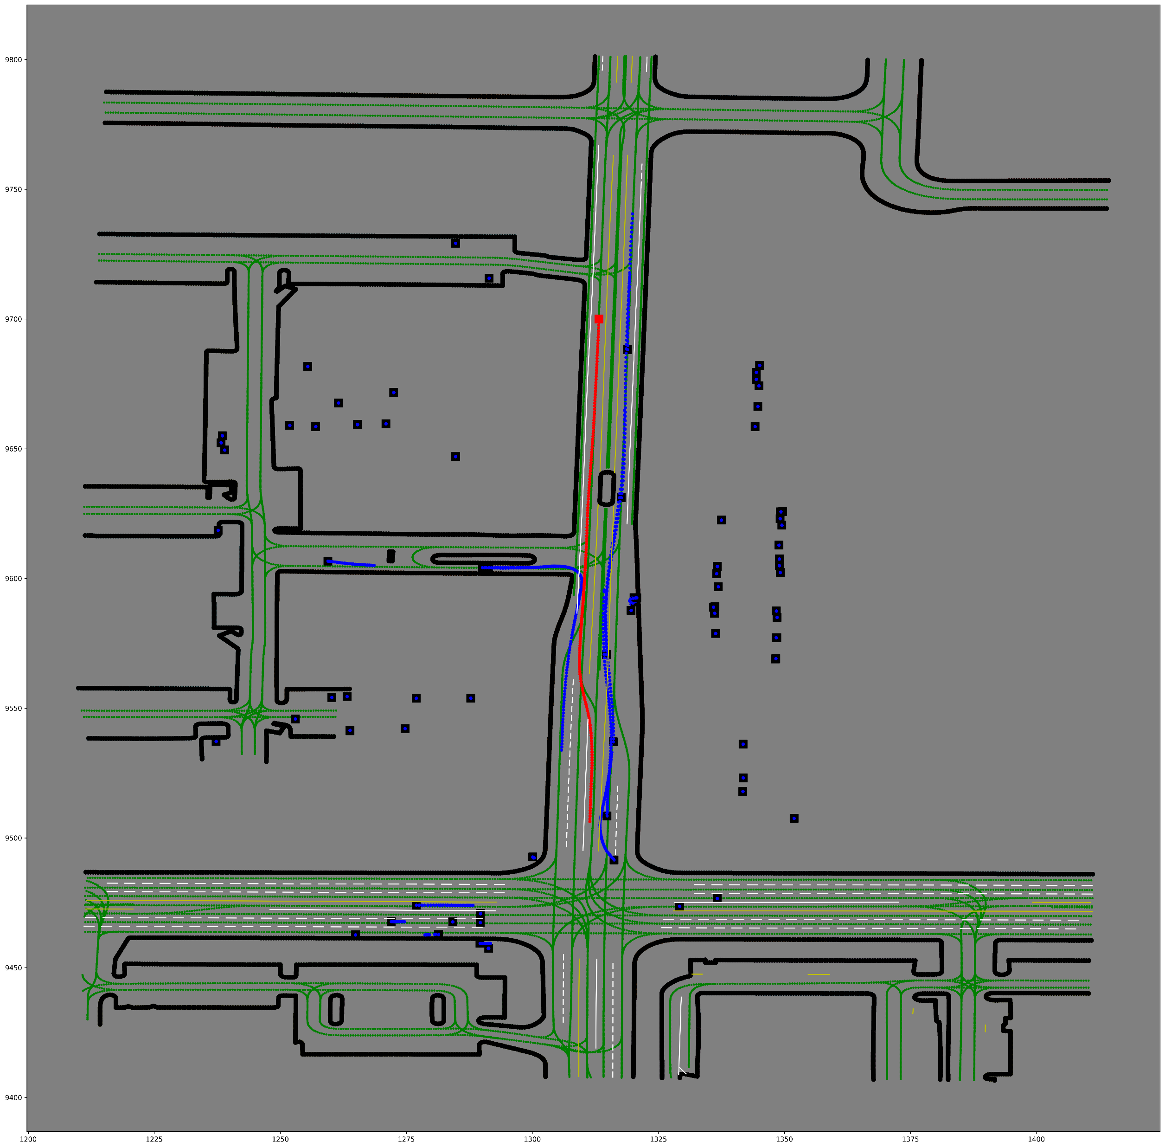
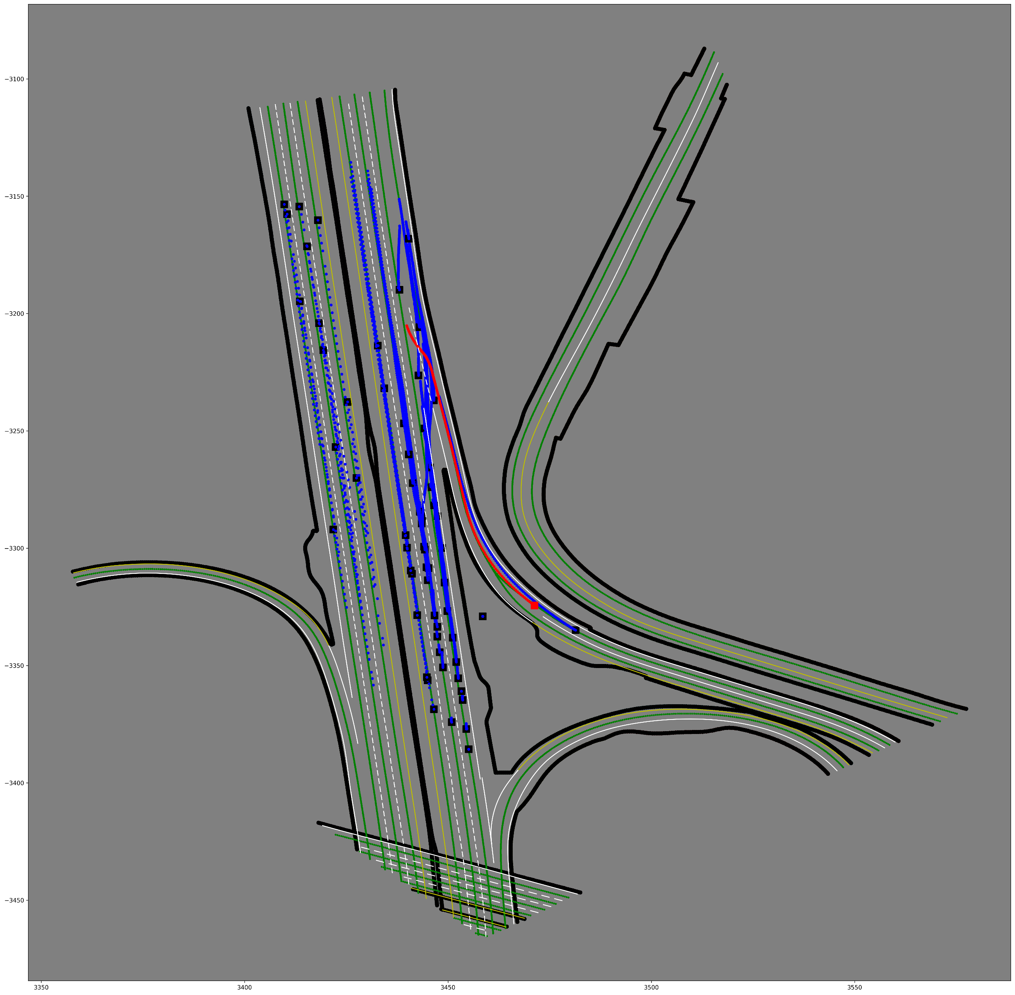
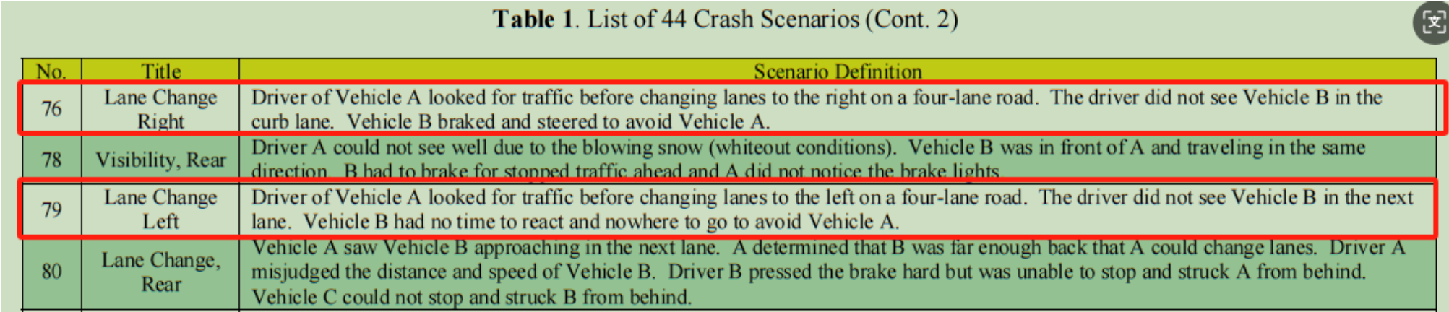
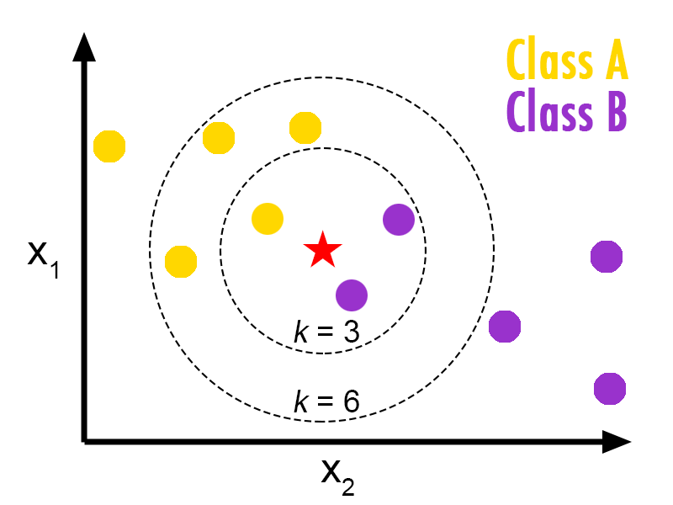
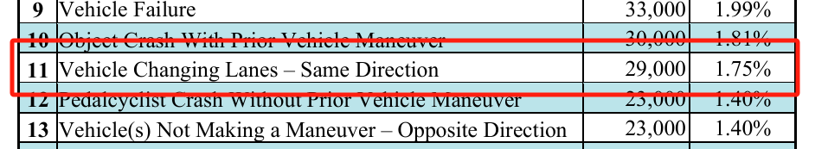
K-NN Based Lane Change Detection
k = 10

Slide 15
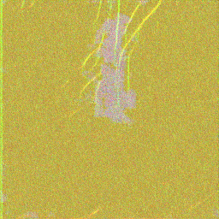
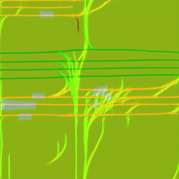

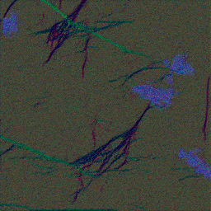
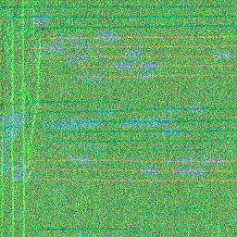
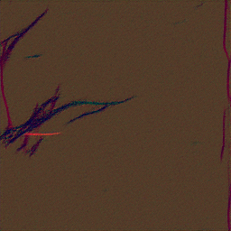
Training Diffusion Model: Pic in Mixture! Underfitting
Very close to some real data
Selected Dataset Characteristic | Parameters
Image Size | 256 x 256
Number of Scenarios | 5102
Selected Diffusion Model | Parameters
Learning Rate | 1e5
Epoch | 30
Parameter | 56,574,595
UNet Model Result for 30 Epochs

Slide 16
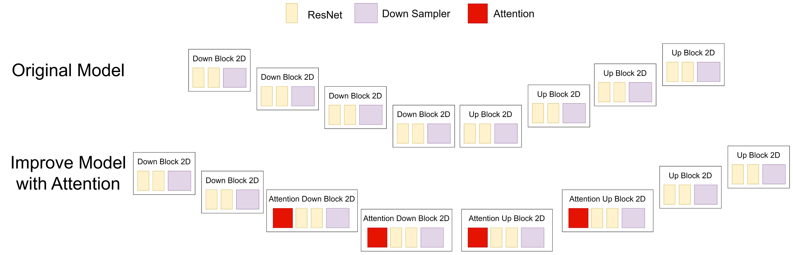
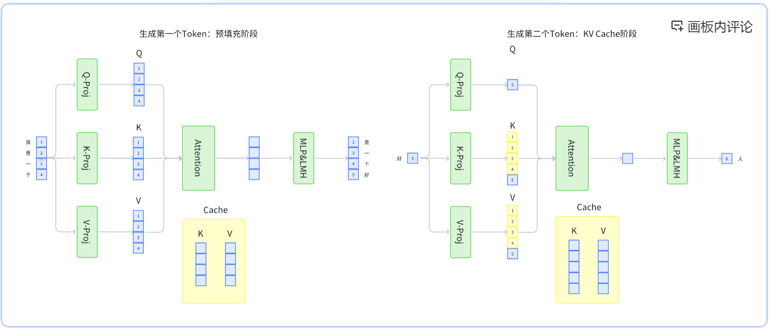
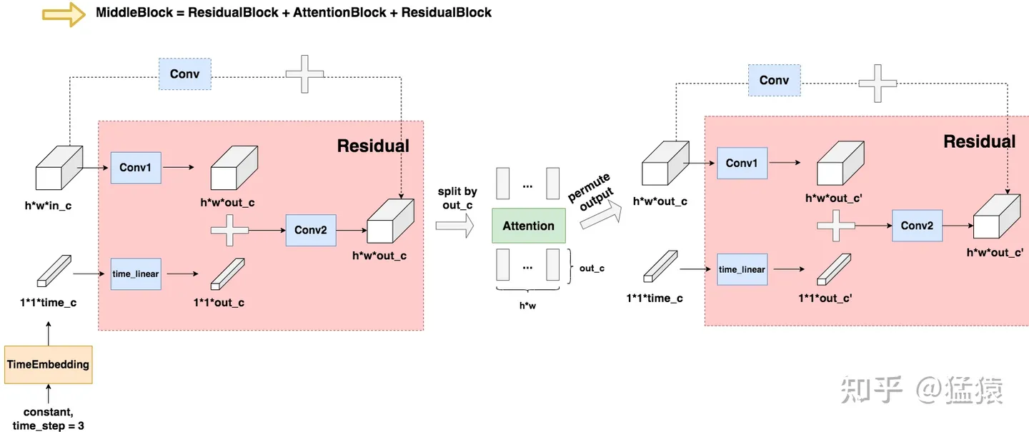
Solution: Attention Block
Notes:
模型训练更快
放Attention的图片
Train time 更少
参数更多
学习率，更新后的Loss更好

Slide 17
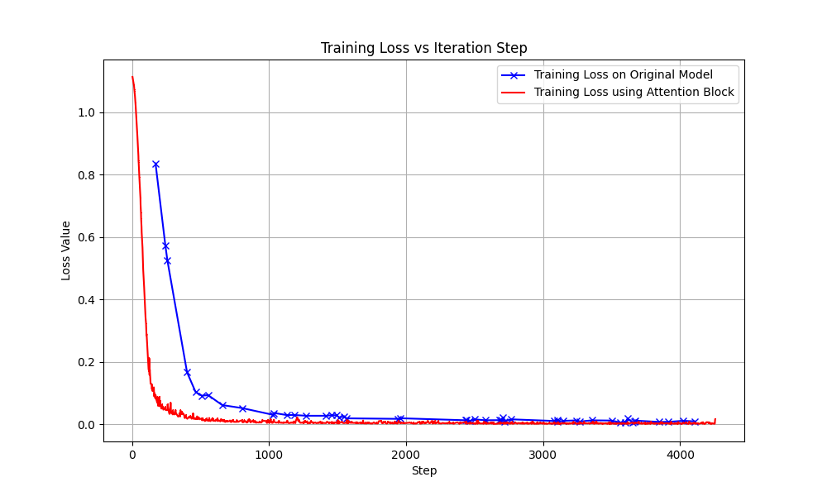
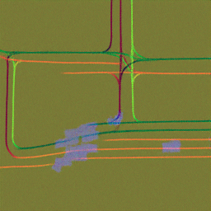
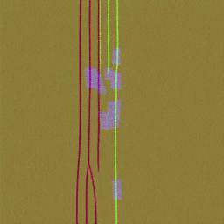
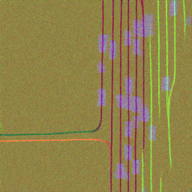
Attention Improvement

Slide 18
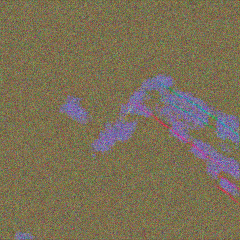




Problem: Models are expensive to train
Observation:
Expensive training time since attention block has too many parameters
Model needs further denoising
Hard to profile

Slide 19







DDIM Scheduler: Stride Sampling
DDPM
Iteration steps: 0 1 2 3 4 5 ……
DDIM
Iteration steps: 0 5 10 15 20 ……
We Suppose:
We Suppose:

Slide 20


DDIM Scheduler
Boost Sampling
Keep variance

Slide 21








DDIM Optimization

Slide 22






Motivation: Fine tune the model Solution: Bayesian optimization
Gaussian Process
Probability of Improvement
Expected Improvement
SMBO
Attention block
Faster Sampling: DDIM Scheduler Denoising Diffusion Implicit Models
Batch size = 36, GPU mem = 75GB

Slide 23



Bayesian Optimization on Optuna
Best value at Iter 21
Hyper Parameter | Optimal Value
Number of Epochs | 30
Learning Rate | 0.00009934870757755

Slide 24








Better Generation after Bayesian Optimization
Epoch: 25
Learning Rate: 0.0005
Epoch: 30
Learning Rate: 0.0000993

Slide 25





Motivation: No current fitter for Carla
?
CARLA 0.9.15

Slide 26




Solution: Graph based parser

Slide 27







Implementation
3000 lines from [14] RA-L 2024 and about 2000 lines python
NVIDIA A100 X 3 from SUSTech HPC Lab
CARLA 0.9.15
20+ Experiment
50+ Training
20+ Testing
Jobs Type | Cost Time | Total Train
Training | 1 hour/Epoch | About 800 Epoch
Generation | 3 min/image | About 10000 sample
CARLA Simulation | 20 min/Scenario | Over 20 Scenario
Intel(R) Xeon(R)
Gold 5320 CPU @ 2.20GHz

Slide 28



Experiment
1. Critical Scenario Comparison
2. Attention Comparison
3. DDIM Comparison
4. Bayesian Optimization Comparison
5. Parser demo

Slide 29



Critical Scenarios Selection
Comparison
Turn Around
Acceleration
Change Line
Notes:
这里是展示我们是不是危险的
比如平均速度，场景的实际情况是不是这样等等

Slide 30






Baseline VS Attention
Comparison
Notes:
这里展示： 无Attention，有Attention, 有Attention+DDIM

Slide 31











Comparison
Original UNet Baseline
5 epoch
15 epoch
30 epoch
50 epoch
UNet 2D Model With Attention block and DDIM Scheduler
3 epoch
5 epoch
15 epoch
30 epoch

Slide 32




Bayesian Optimization
Comparison
Turn around Scenario
Turn around Scenario
Notes:
这里展示我们在Attention+DDIM情况下的结果

Slide 33



Simulation Steps

Slide 34
Parser demo
【机器学习 Grand Finale】 https://www.bilibili.com/video/BV1ZPcxeFEP2/?share_source=copy_web&vd_source=72eac555730ba7e7a64f9fa1d7f2b2d4
See on bili
Bilibili:
BV1ZPcxeFEP2
Notes:
这里展示我们的Parser情况
可以来一个视频

Slide 35
Conclusion

Slide 36
Project Recording
Project Recording | Status | links
Report | ✅ | CrashSimGen: Final ML Project - Online LaTeX Editor Sharelatex by SUSTech CRA
PPT | ✅ | https://www.haibinlaiblog.top/wp-content/uploads/2025/01/ML_DM.pptx
Demo | ✅ | https://github.com/HaibinLai/CrashSimGen/tree/main/Demo
Code | ✅ | https://github.com/HaibinLai/CrashSimGen
Video | ✅ | 【机器学习 Grand Finale】 https://www.bilibili.com/video/BV1ZPcxeFEP2
Website | ✅ | https://haibinlai.github.io/CrashSimGen/
Poster | WIP | WIP

Slide 37
Future work
Precise Data Selection
More selection rules on NHTSA37
Model Further Improvement
UNet2DModel -> UNet2DConditionalModel For Multihead Attention
DDIM Scheduler -> PLMS
A Complete Parser
Add more pedestrian movement
Traffic Sign

Slide 38

IROS

Slide 39
Reference
[1] A. Demetriou, H. Allsvåg, S. Rahrovani and M. H. Chehreghani, "Generation of Driving Scenario Trajectories with Generative Adversarial Networks," 2020 IEEE 23rd International Conference on Intelligent Transportation Systems (ITSC), Rhodes, Greece, 2020, pp. 1-6, doi: 10.1109/ITSC45102.2020.9294362.
[2] W. Ding, B. Chen, B. Li, K. J. Eun and D. Zhao, "Multimodal Safety-Critical Scenarios Generation for Decision-Making Algorithms Evaluation," in IEEE Robotics and Automation Letters, vol. 6, no. 2, pp. 1551-1558, April 2021, doi: 10.1109/LRA.2021.3058873.
[3] Wenhao Ding, Baiming Chen, Minjun Xu, and Ding Zhao. 2020. Learning to Collide: An Adaptive Safety-Critical Scenarios Generating Method. In 2020 IEEE/RSJ International Conference on Intelligent Robots and Systems (IROS). IEEE Press, 2243–2250. https://doi.org/10.1109/IROS45743.2020.9340696
[4] W. Ding, W. Wang and D. Zhao, "A Multi-Vehicle Trajectories Generator to Simulate Vehicle-to-Vehicle Encountering Scenarios," 2019 International Conference on Robotics and Automation (ICRA), Montreal, QC, Canada, 2019, pp. 4255-4261, doi: 10.1109/ICRA.2019.8793776.
[5] Wenhao Ding, Chejian Xu, Mansur Arief, Haohong Lin, Bo Li, and Ding Zhao. 2023. A Survey on Safety-Critical Driving Scenario Generation&amp;#x2014;A Methodological Perspective. Trans. Intell. Transport. Sys. 24, 7 (July 2023), 6971–6988. https://doi.org/10.1109/TITS.2023.3259322
[6] Goodfellow, I.J., Shlens, J., & Szegedy, C. (2014). Explaining and Harnessing Adversarial Examples. CoRR, abs/1412.6572.
[7] Guo, Yaohui, Vinay Varma Kalidindi, Mansur Arief, Wenshuo Wang, Jiacheng Zhu, Huei Peng and Ding Zhao. “Modeling Multi-Vehicle Interaction Scenarios Using Gaussian Random Field.” 2019 IEEE Intelligent Transportation Systems Conference (ITSC) (2019): 3974-3980.
[8] K. Hao, W. Cui, L. Liu, Y. Pan and Z. Yang, "Integrating Data-Driven and Knowledge-Driven Methodologies for Safety-Critical Scenario Generation in Autonomous Vehicle Validation," 2024 IEEE 24th International Conference on Software Quality, Reliability, and Security Companion (QRS-C), Cambridge, United Kingdom, 2024, pp. 970-981, doi: 10.1109/QRS-C63300.2024.00129.
[9] Harshvardhan GM, Mahendra Kumar Gourisaria, Manjusha Pandey, and Siddharth Swarup Rautaray. 2020. A comprehensive survey and analysis of generative models in machine learning. Comput. Sci. Rev. 38, C (Nov 2020). https://doi.org/10.1016/j.cosrev.2020.100285
[10] Jonathan Ho, Ajay Jain, and Pieter Abbeel. 2020. Denoising diffusion probabilistic models. In Proceedings of the 34th International Conference on Neural Information Processing Systems (NIPS '20). Curran Associates Inc., Red Hook, NY, USA, Article 574, 6840–6851.

Slide 40
Reference
[11] Huang, Zhiyu, Zixu Zhang, Ameya Vaidya, Yuxiao Chen, Chen Lv and Jaime Fern'andez Fisac. “Versatile Behavior Diffusion for Generalized Traffic Agent Simulation.” (2024).
[12] Pronovost, Ethan, Meghana Reddy Ganesina, Noureldin Hendy, Zeyu Wang, Andres Morales, Kai Wang and Nicholas Roy. “Scenario Diffusion: Controllable Driving Scenario Generation With Diffusion.” ArXiv abs/2311.02738 (2023): n. pag.
[13] S. Riedmaier, T. Ponn, D. Ludwig, B. Schick and F. Diermeyer, "Survey on Scenario-Based Safety Assessment of Automated Vehicles," in IEEE Access, vol. 8, pp. 87456-87477, 2020, doi: 10.1109/ACCESS.2020.2993730.
[14] S. Sun et al., "DriveSceneGen: Generating Diverse and Realistic Driving Scenarios From Scratch," in IEEE Robotics and Automation Letters, vol. 9, no. 8, pp. 7007-7014, Aug. 2024, doi: 10.1109/LRA.2024.3416792.
[15] R. S. Sutton and A. G. Barto, "Reinforcement Learning: An Introduction," in IEEE Transactions on Neural Networks, vol. 9, no. 5, pp. 1054-1054, Sept. 1998, doi: 10.1109/TNN.1998.712192.
[16] Yang, Chen, Aaron Xuxiang Tian, Dong Chen, Tianyu Shi and Arsalan Heydarian. “WcDT: World-centric Diffusion Transformer for Traffic Scene Generation.” ArXiv abs/2404.02082 (2024): n. pag.[8] K. Hao, W. Cui, L. Liu, Y. Pan and Z. Yang, "Integrating Data-Driven and Knowledge-Driven Methodologies for Safety-Critical Scenario Generation in Autonomous Vehicle Validation," 2024 IEEE 24th International Conference on Software Quality, Reliability, and Security Companion (QRS-C), Cambridge, United Kingdom, 2024, pp. 970-981, doi: 10.1109/QRS-C63300.2024.00129.
[17] Z. Yang et al., "SurfelGAN: Synthesizing Realistic Sensor Data for Autonomous Driving," 2020 IEEE/CVF Conference on Computer Vision and Pattern Recognition (CVPR), Seattle, WA, USA, 2020, pp. 11115-11124, doi: 10.1109/CVPR42600.2020.01113. keywords: {Image reconstruction;Three-dimensional displays;Cameras;Laser radar;Autonomous vehicles;Training;Rendering (computer graphics)},
[18] Hugging Face, "Stable Diffusion: Effective Diffusion Model," Hugging Face. [Online]. Available: https://hugging-face.cn/docs/diffusers/stable_diffusion. [Accessed: Jan. 4, 2025].
[19] J. Zhang, C. Xu and B. Li, "ChatScene: Knowledge-Enabled Safety-Critical Scenario Generation for Autonomous Vehicles," 2024 IEEE/CVF Conference on Computer Vision and Pattern Recognition (CVPR), Seattle, WA, USA, 2024, pp. 15459-15469, doi: 10.1109/CVPR52733.2024.01464.

Slide 41
Reference
[20] Zhong, Ziyuan, Yun Tang, Yuan Zhou, Vânia de Oliveira Neves, Yang Liu and Baishakhi Ray. “A Survey on Scenario-Based Testing for Automated Driving Systems in High-Fidelity Simulation.” ArXiv abs/2112.00964 (2021): n. pag.
[21] Zhong, Z., Rempe, D., Xu, D., Chen, Y., Veer, S., Che, T., Ray, B., & Pavone, M. (2022). Guided conditional diffusion for controllable traffic simulation. arXiv. https://arxiv.org/abs/2210.17366
[22] Zhou, Ming, Jun Luo, Julian Villela, Yaodong Yang, David Rusu, Jiayu Miao, Weinan Zhang, Montgomery Alban, Iman Fadakar, Zheng Chen, Aurora Chongxi Huang, Ying Wen, Kimia Hassanzadeh, Daniel Graves, Dong Chen, Zhengbang Zhu, Nhat M. Nguyen, Mohamed ElSayed, Kun Shao, Sanjeevan Ahilan, Baokuan Zhang, Jiannan Wu, Zhengang Fu, Kasra Rezaee, Peyman Yadmellat, Mohsen Rohani, Nicolas Perez Nieves, Yihan Ni, Seyedershad Banijamali, Alexander Cowen Rivers, Zheng Tian, Daniel Palenicek, Haitham Ammar, Hongbo Zhang, Wulong Liu, Jianye Hao and Jun Wang. “SMARTS: Scalable Multi-Agent Reinforcement Learning Training School for Autonomous Driving.” ArXiv abs/2010.09776 (2020): n. pag.
[23] Dosovitskiy, Alexey, Germán Ros, Felipe Codevilla, Antonio M. López and Vladlen Koltun. “CARLA: An Open Urban Driving Simulator.” Conference on Robot Learning (2017).
[24] Hanqun Cao, Cheng Tan, Zhangyang Gao, Yilun Xu, Guangyong Chen, Pheng-Ann Heng, and Stan Z. Li. 2024. A Survey on Generative Diffusion Models. IEEE Trans. on Knowl. and Data Eng. 36, 7 (July 2024), 2814–2830. https://doi.org/10.1109/TKDE.2024.3361474

Slide 42

Thank you!

